Slide 1
Graduation Project
EG-CompBio
BCB Diploma SS2026
INTR-CADS
By: Omar Khaled

Slide 2
PyProteoMass
An Automated Pipeline for Genome-Scale Protein Weight Calculation and Locus Tag Mapping
High-Throughput Proteome Profiling in Escherichia coli and Saccharomyces cerevisiae

Slide 3
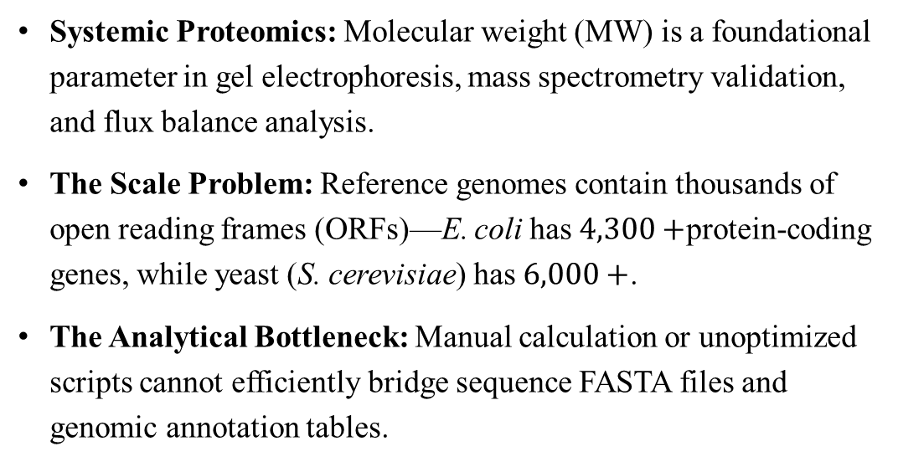
Why Proteome-Wide Mass Profiling Matters
Systemic Proteomics: Molecular weight ($\text{MW}$) is a foundational parameter in gel electrophoresis, mass spectrometry validation, and flux balance analysis.
The Scale Problem: Reference genomes contain thousands of open reading frames (ORFs)—E. coli has $4,300+$protein-coding genes, while yeast (S. cerevisiae) has $6,000+$.
The Analytical Bottleneck: Manual calculation or unoptimized scripts cannot efficiently bridge sequence FASTA files and genomic annotation tables.

Slide 4
Challenges in Genomic Annotation
Challenge 1: Naïve Mass Summation Errors
Simple summation of free amino acids overestimates total weight by ignoring peptide bond condensation reactions.
Challenge 2: Memory Exhaustion on Large Datasets
Loading multi-megabyte sequence files entirely into system memory causes performance degradation or memory crashes.
Challenge 3: Heterogeneous NCBI File Formats
Public databases frequently shift header names between legacy .ptt files, .csv, and modern _feature_table.txt formats (e.g., locus_tag vs. Synonym vs. Locus Tag).

Slide 5
Core Goals & System Specifications
Biochemical Accuracy: Implement the exact stoichiometric condensation equation with sequence sanitization.
High-Throughput Performance: Process complete reference proteomes in under 3 seconds using generator-based streaming.
Dynamic Format Resolution: Auto-detect delimiters and column headers across varying NCBI annotation tables.
Clean Output: Export a standardized two-column CSV (locus_tag, Molecular_Weight_Da) ready for downstream pipeline ingestion.

Slide 6
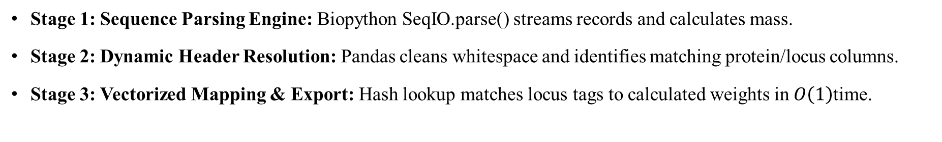
PyProteoMass Pipeline Architecture
Stage 1: Sequence Parsing Engine: Biopython SeqIO.parse() streams records and calculates mass.
Stage 2: Dynamic Header Resolution: Pandas cleans whitespace and identifies matching protein/locus columns.
Stage 3: Vectorized Mapping & Export: Hash lookup matches locus tags to calculated weights in $O\left(1\right)$time.
[ FASTA (.faa) ] ---> ( Biopython Generator Stream ) ---> [ Mass Dict {ID: MW} ]
|
v
[ Tabular (.tsv) ] ---> ( Dynamic Header Resolver ) ---> [ Vectorized .map() ] ---> [ Final CSV ]

Slide 7
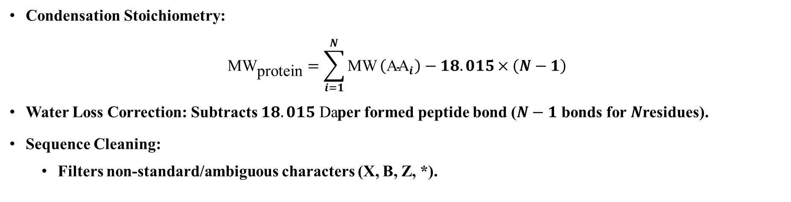
Calculation & Sequence Cleaning
Condensation Stoichiometry:
$${\text{MW}}_{\text{protein}}=\sum_{i=1}^{N}{\text{MW}}\left({\text{AA}}_{i}\right)−18.015×\left(N−1\right)$$
Water Loss Correction: Subtracts $18.015\text{ Da}$per formed peptide bond ($N−1$ bonds for $N$residues).
Sequence Cleaning:
  Filters non-standard/ambiguous characters (X, B, Z, *).

Slide 8
Memory Efficiency & Vectorized Performance
Iterative Memory Generator (Bio.SeqIO):
Streams FASTA records sequentially without storing unparsed sequences in RAM.
Vectorized Hash Lookup (pandas.Series.map):
Replaces slow Python for loops with C-optimized hash table lookups.
Instantaneously maps thousands of protein accession IDs to locus tags.
Dynamic Column Auto-Detection:
Case-insensitive candidate searching resolves header naming inconsistencies automatically.
Keeps memory utilization constant regardless of proteome size.

Slide 9
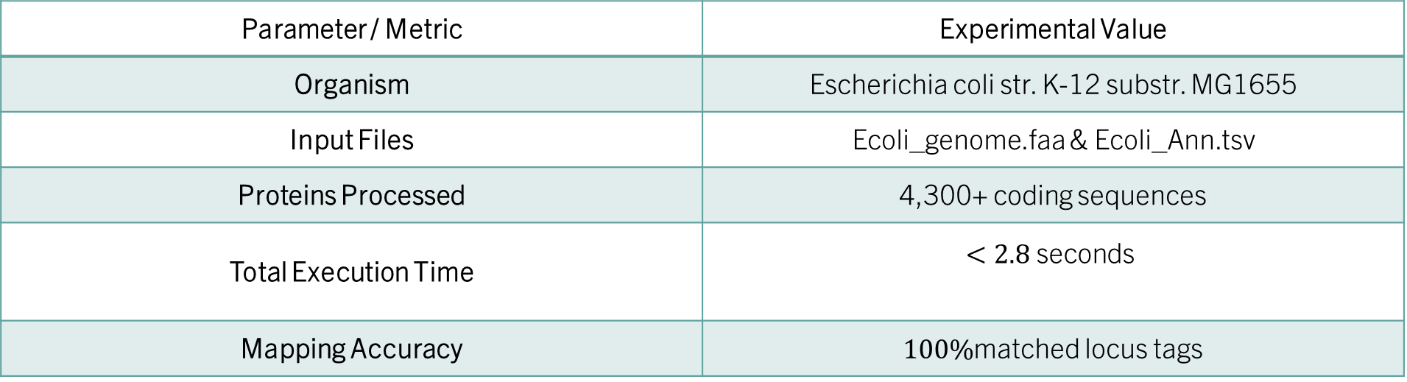
Validation on Escherichia coli MG1655
Parameter / Metric | Experimental Value
Organism | Escherichia coli str. K-12 substr. MG1655
Input Files | Ecoli_genome.faa & Ecoli_Ann.tsv
Proteins Processed | 4,300+ coding sequences
Total Execution Time | $$<2.8\text{ seconds}$$
Mapping Accuracy | $100\%$matched locus tags

Slide 10
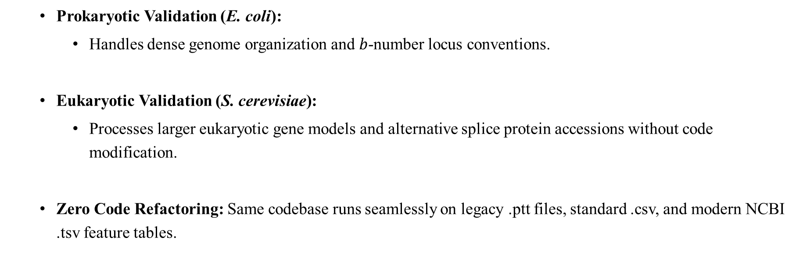
Adaptability Across Species Datasets
  Prokaryotic Validation (E. coli):
    Handles dense genome organization and $b$-number locus conventions.
  Eukaryotic Validation (S. cerevisiae):
    Processes larger eukaryotic gene models and alternative splice protein accessions without code modification.
  Zero Code Refactoring: Same codebase runs seamlessly on legacy .ptt files, standard .csv, and modern NCBI .tsv feature tables.

Slide 11
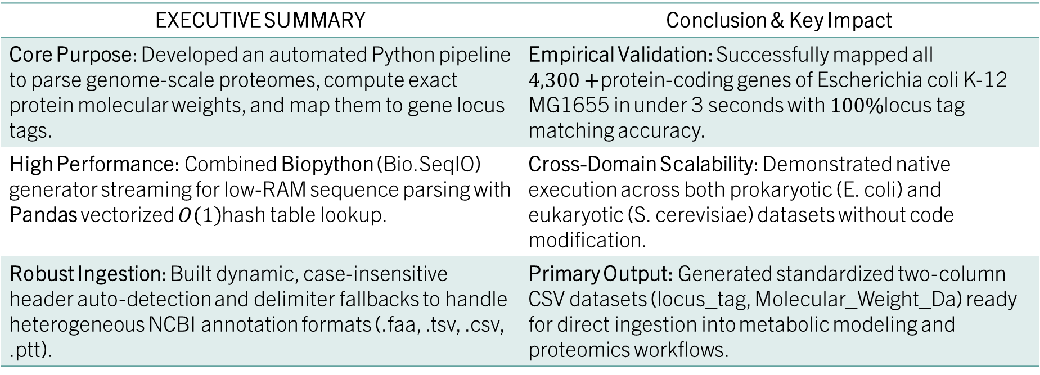
PyProteoMass: Summary & Conclusion
EXECUTIVE SUMMARY | Conclusion & Key Impact
Core Purpose: Developed an automated Python pipeline to parse genome-scale proteomes, compute exact protein molecular weights, and map them to gene locus tags. | Empirical Validation: Successfully mapped all $4,300+$protein-coding genes of Escherichia coli K-12 MG1655 in under 3 seconds with $100\%$locus tag matching accuracy.
High Performance: Combined Biopython (Bio.SeqIO) generator streaming for low-RAM sequence parsing with Pandas vectorized $O\left(1\right)$hash table lookup. | Cross-Domain Scalability: Demonstrated native execution across both prokaryotic (E. coli) and eukaryotic (S. cerevisiae) datasets without code modification.
Robust Ingestion: Built dynamic, case-insensitive header auto-detection and delimiter fallbacks to handle heterogeneous NCBI annotation formats (.faa, .tsv, .csv, .ptt). | Primary Output: Generated standardized two-column CSV datasets (locus_tag, Molecular_Weight_Da) ready for direct ingestion into metabolic modeling and proteomics workflows.

Slide 12
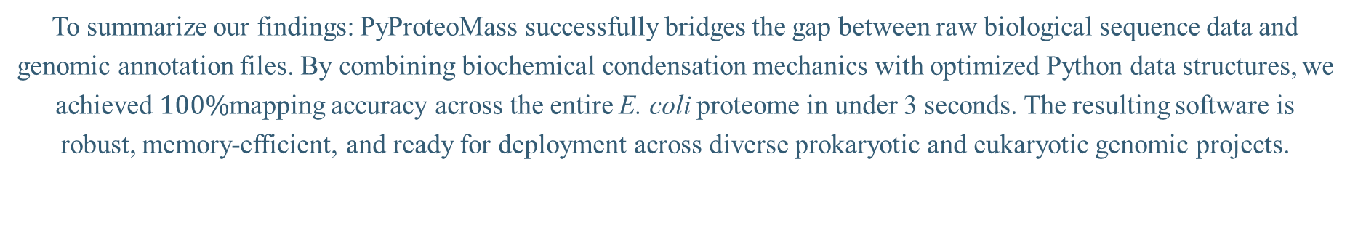
Finally!
To summarize our findings: PyProteoMass successfully bridges the gap between raw biological sequence data and genomic annotation files. By combining biochemical condensation mechanics with optimized Python data structures, we achieved $100\%$mapping accuracy across the entire E. coli proteome in under 3 seconds. The resulting software is robust, memory-efficient, and ready for deployment across diverse prokaryotic and eukaryotic genomic projects.

Slide 13
Thank You!

